Slide 1
Completions
Safety, Speed, Efficiency, Real Time Statistics and Progress

Slide 2

Unlike faceless EPCMs we specialize in completions

Slide 3
Our Team has Decades of Experience
Many successful projects
Hundreds of lessons learned
We know what pitfalls to avoid
Provide input and guidance at the early design stages to reduce costs later

Slide 4
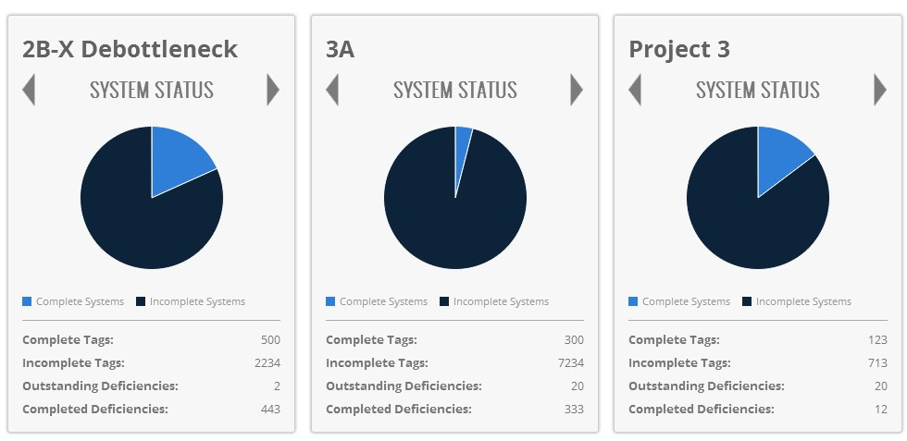
Multiple Project Reporting

Slide 5
Multiple Independent Tag Hierarchies
Say what?
We provide a customizable View Point on the Project / Completions Status from an EWP / CWP; Sub-System / System or Area perspective
Every discipline and department can roll up the numbers as fits their purpose

Slide 6
Project Dashboards
Provide information at a glance
Can provide hourly, daily, weekly or monthly progress reports
Are configurable for each user so that only the important information is shown

Slide 7
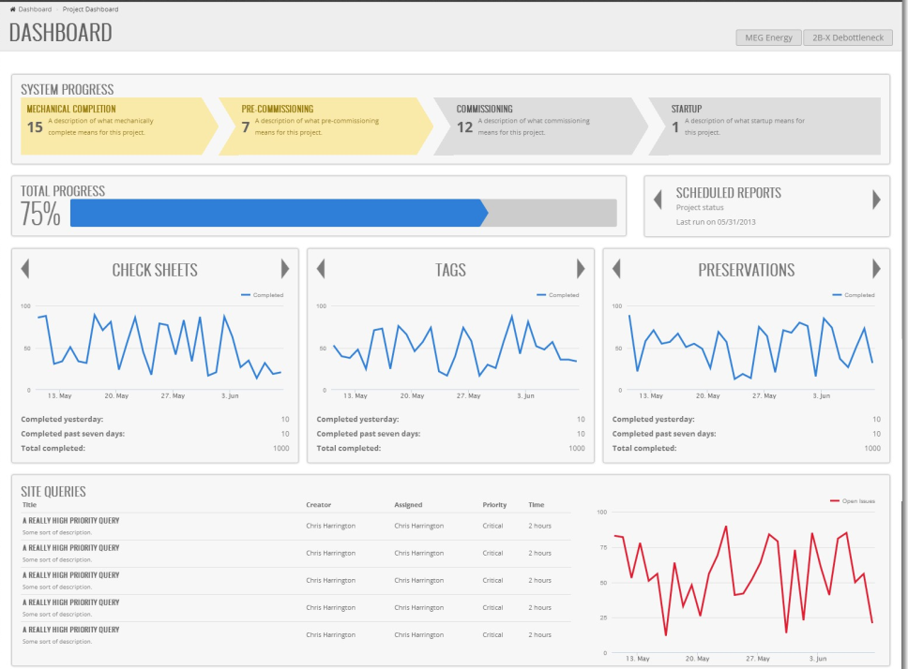
Project Dashboards

Slide 8

Well Thought Out Design
Designed for the average user
Complexity is hidden
Intuitive to use with minimal training
Usability is key
Our application is built around making common tasks such as scoping easy

Slide 9
Check Sheet Generation
Barcoded check sheets with your check sheets or choose from our library of check sheets
Generated check sheets(ITRs) can be prepopulated with any information you choose: tag number, system number, even test pressures

Slide 10
Check Sheet Scanning
Scanning automatically splits multiple sheets in a single document
Supporting documentation can be attached to check sheets
Pages scanned upside-down are automatically rotated
Automatic completion of barcoded check sheets saves several FTEs

Slide 11
Turnover Package Creation
Creating turnover packages has traditionally been time consuming and manual
We already have most of the documentation in the system and can generate a skeleton turnover package in a matter of minutes
No longer will you have to scramble for check sheets or report to include in a turnover package

Slide 12
Rapid Response
Team is local and has experience with the needs of site
We’re highly available, highly responsive and you never have to wait 8 hours for somebody in Norway or Australia to get into the office

Slide 13
Templated Tag Entry
Many facilities have duplicated areas such as well pads or pump stations
We speed up information entry by allowing for a set of tags to be set up as a template and duplicated

Slide 14
Preservation
Missed preservation actions can be costly and dangerous
Incorrect equipment storage poses a threat to the project timeline and cost

Slide 15
Preservations
Provides verification that required preservation tasks have been completed
Provides scheduling and notification of upcoming tasks, and notification reports of delinquent required activities
Provides and archives an auditable preservation record for all equipment
Track upcoming and delinquent preservations
Instrument preservations by contractor to ensure no one contractor is the source of missed completions
Generate work cards

Slide 16
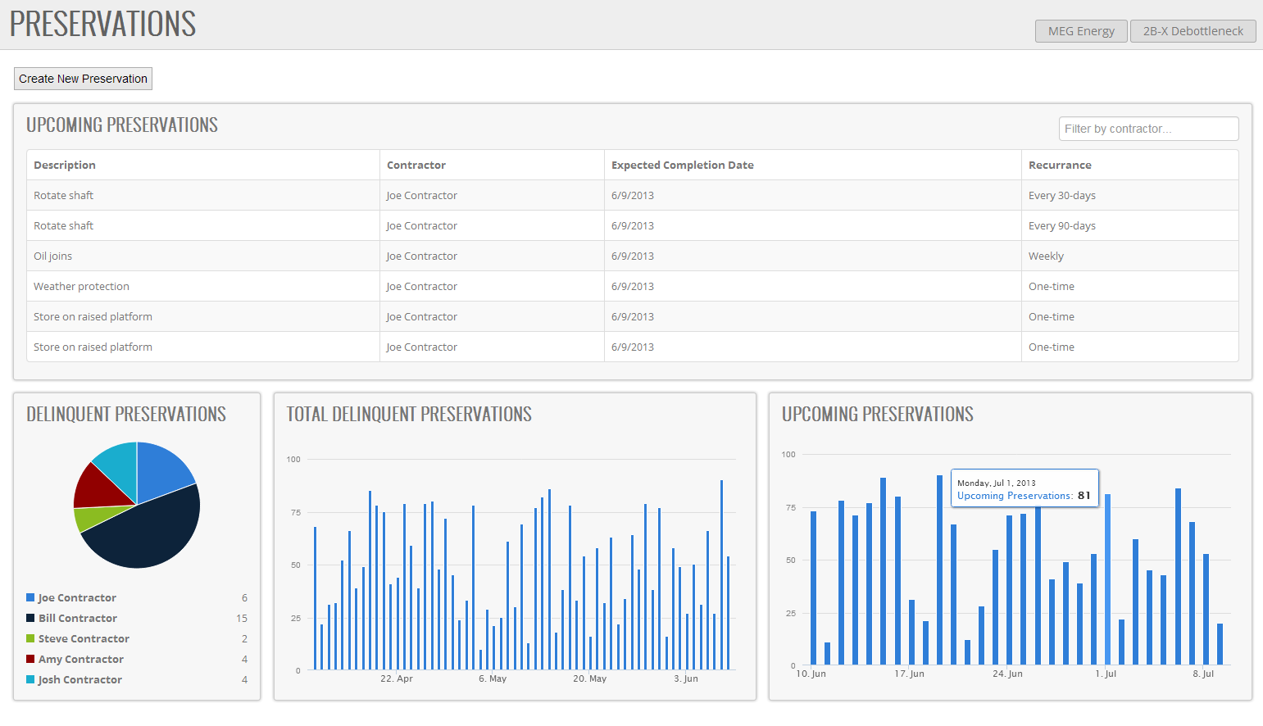
Preservations

Slide 17
Field Entry Devices
A common bottleneck in completions is the processing of check sheets
We eliminate this by providing tablets in the field which automatically sync with the completions database
This provides a real-time view of completions and further reduces staffing requirements

Slide 18
Deficiency Tracking
Tracking of deficiencies identified during walkdowns is traditionally time consuming
We provide a rapid entry tool on tablets to manage punch item generation and sign off
Photos and drawings can be attached to communicate exactly what the problem is
Utilize secure electronic signatures

Slide 19


Slide 20
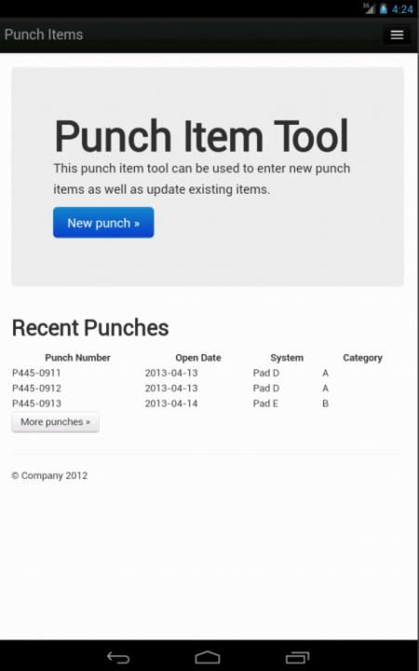
Android Punch Item Tool

Slide 21
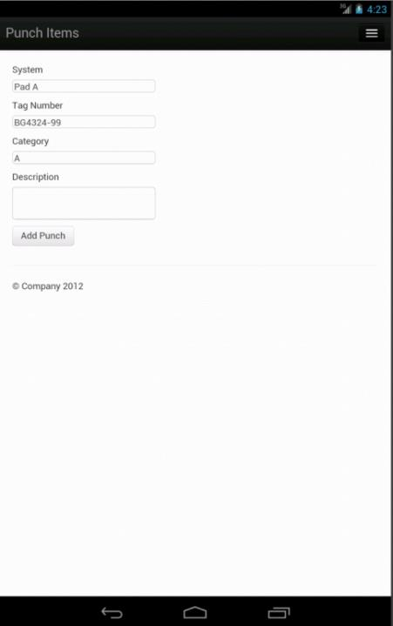
Android Punch Item Tool

Slide 22
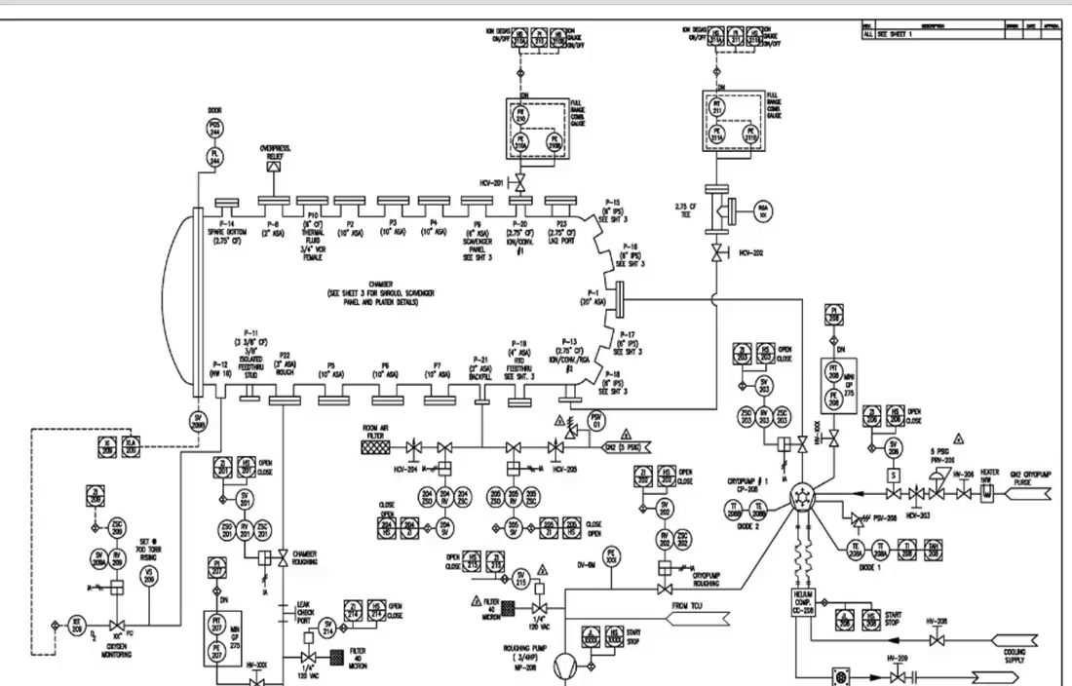
Browser Based PnID Markup and Scoping
Notes:
This is a video. Click to play.

Slide 23
Advanced Reporting
Skylines
Graphs
Printable dashboards
Animations
We believe in delighting our users

Slide 24
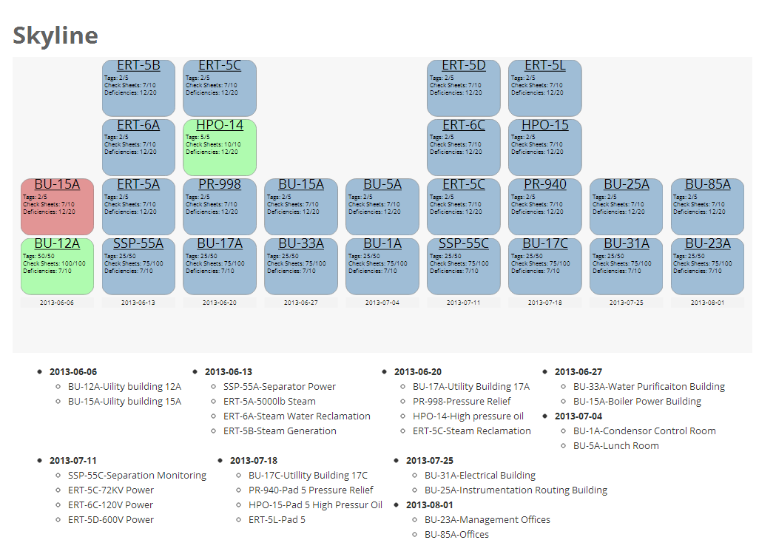
Skyline

Slide 25
Elastic Completions
Unlike regular completions groups we work on multiple projects at once
You only pay for the hours you need

Slide 26
Traditional
Insufficient capacity causing delay
Resources wasted

Slide 27
Elastic Completions
Resourcing matches demand

